Slide 1
KRAS target dossier - pancreatic cancer
06-08-2024

Slide 2
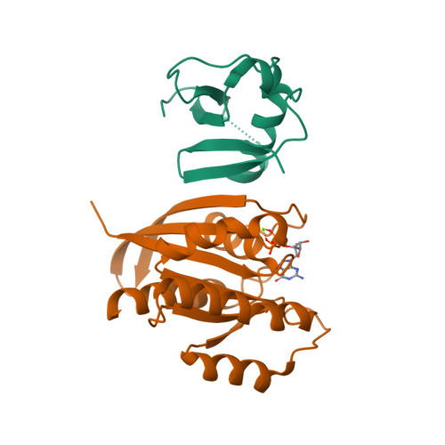
Target summary
This gene, a Kirsten ras oncogene homolog from the mammalian ras gene family, encodes a protein that is a member of the small GTPase superfamily. A single amino acid substitution is responsible for an activating mutation. The transforming protein that results is implicated in various malignancies, including lung adenocarcinoma, mucinous adenoma, ductal carcinoma of the pancreas and colorectal carcinoma. Alternative splicing leads to variants encoding two isoforms that differ in the C-terminal region. [provided by RefSeq, Jul 2008]
KRAS protein structure
Source: NCBI Gene and RCSB
Notes:
Summary: https://www.ncbi.nlm.nih.gov/gene/3845
Structure image: https://cdn.rcsb.org/images/structures/7vvb_assembly-1.jpeg

Slide 3
Target characteristics
Target characteristics
Name | KRAS
Size | 21.66 kDA
Family | RAS, DI-RAS, AND RHEB FAMILY MEMBERS OF SMALL GTPASE SUPERFAMILY
Subcellular location | Cell membrane, Endomembrane system, Cytoplasm, cytosol
Isoforms | 2A, 2B
AA sequence length | 189
Source: UniProt
Notes:
Source: https://www.uniprot.org/uniprotkb/P01116/entry

Slide 4
Target characteristics
Target characteristics
Similarity with monkeys | 97.01%
Similarity with mice | 98.94%
Similarity with rabbits | 98.94%
Similarity with dogs | 98.94%
Similarity with Guinea pigs | 100.0%
Protein function | Ras proteins regulate cell proliferation by binding GDP/GTP and inducing TSG silencing in CRC cells through ZNF304.
Source: UniProt and BLAST
Notes:
Source: https://www.uniprot.org/uniprotkb/P01116/entry
BLAST for sequence similarity

Slide 5
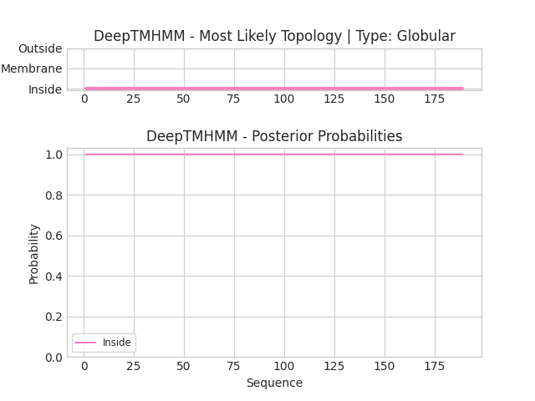
Transmembrane helix prediction
The plot shows the protein prediction topology: the probabilities of the amino acids locations with respect to the the membrane.
The prediction indicates that the entire KRAS protein sequence, consisting of 189 amino acids, is predicted to be located inside the membrane.
Source: DeepTMHMM
Notes:
Predicted by DeepTMHMM (https://dtu.biolib.com/DeepTMHMM)

Slide 6
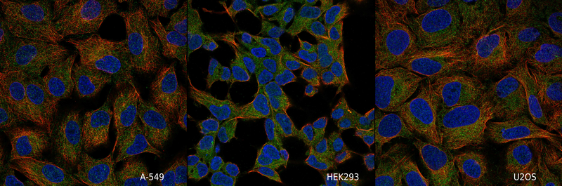
Subcellular location
Localized to the cytosol.
Antigen: HPA072761
KRAS
Nucleus
Microtubules
Source: Human Protein Atlas
Notes:
Source: https://www.proteinatlas.org/ENSG00000133703-KRAS/subcellular
Cell line A-549 origin: Lung
Cell line HEK293 origin: Kidney & Urinary bladder
Cell line U2OS origin: Mesenchymal

Slide 7
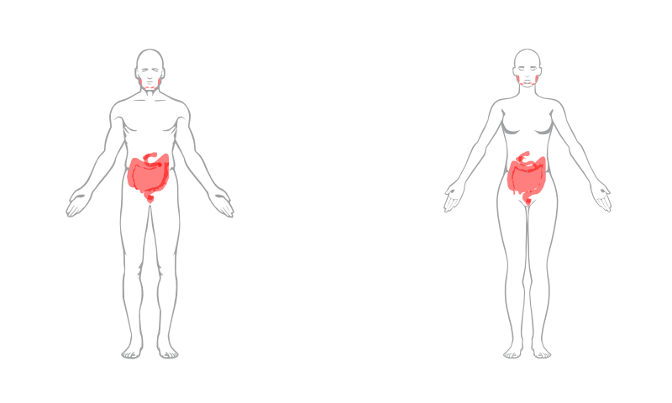
Wild type KRAS protein expression levels
KRAS is highly expressed in Appendix, Colon, Duodenum, Gallbladder, Rectum, Salivary gland, Small intestine
Source: Human Protein Atlas
Notes:
Source: https://www.proteinatlas.org/ENSG00000133703-KRAS/tissue

Slide 8
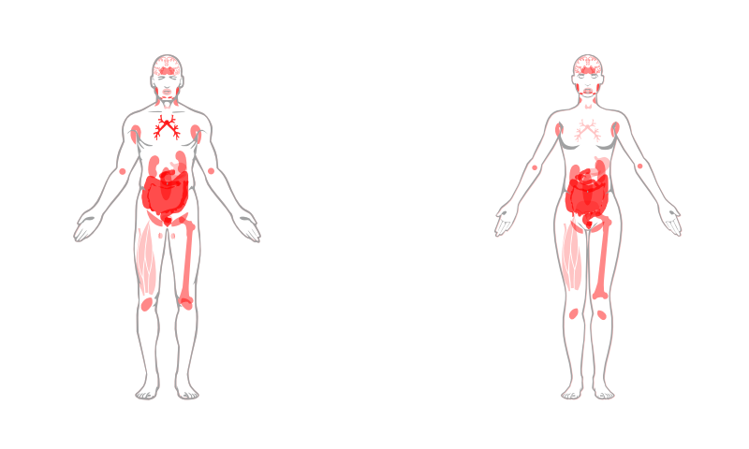
Wild type KRAS protein expression levels
KRAS is highly expressed in Appendix, Colon, Duodenum, Gallbladder, Rectum, Salivary gland, Small intestine
Source: Human Protein Atlas
Notes:
Source: https://www.proteinatlas.org/ENSG00000133703-KRAS/tissue

Slide 9
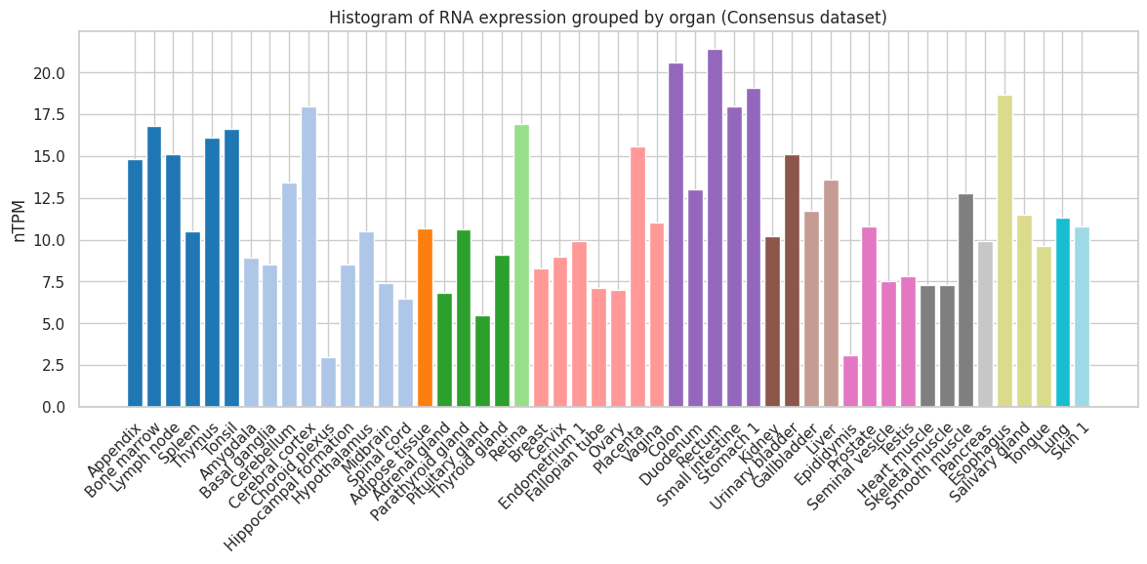
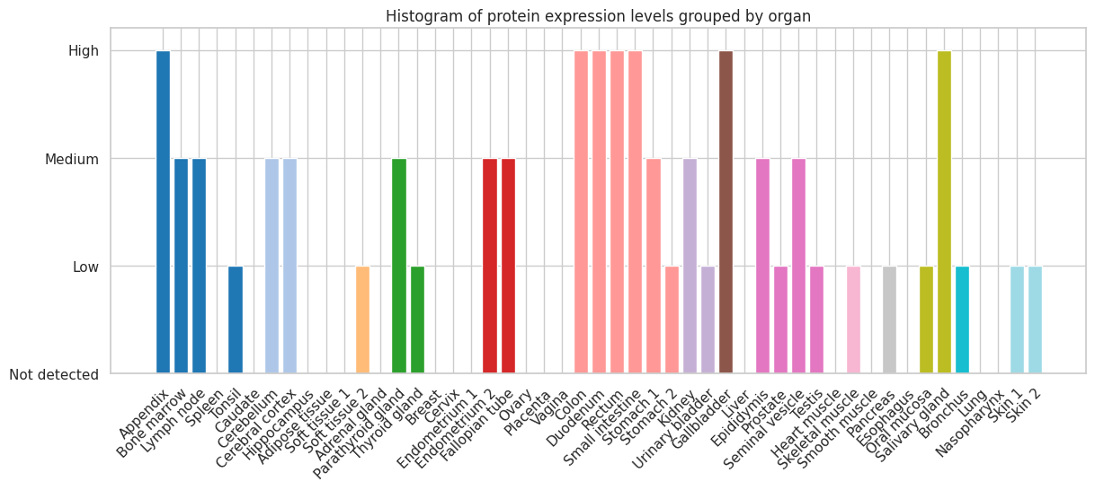
Wild type KRAS expression
Potential toxicity
The tissues with the highest RNA expression of KRAS are: rectum, colon, stomach, esophagus and cerebral cortex.
Source: Human Protein Atlas
Notes:
Source: https://www.proteinatlas.org/ENSG00000133703-KRAS/tissue

Slide 10
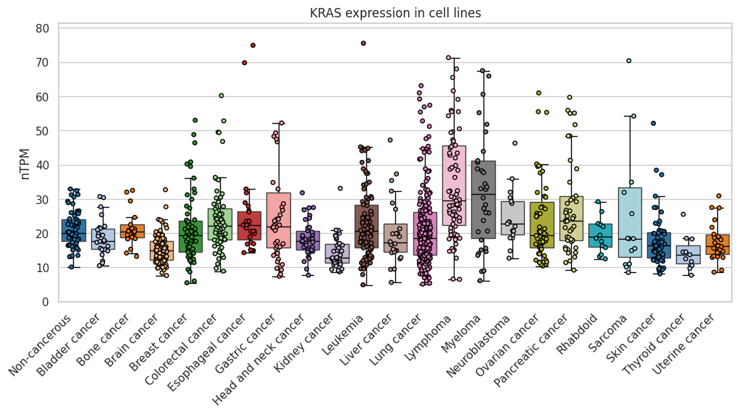
Expression in non cancerous and cancer cell lines
Source: Human Protein Atlas
Notes:
Source: https://www.proteinatlas.org/ENSG00000133703-KRAS/cell+line

Slide 11
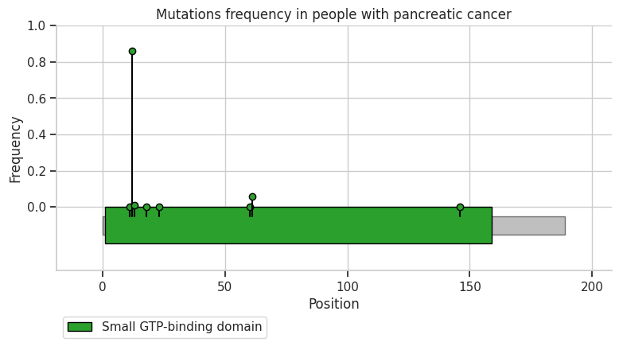
Mutations frequency in pancreatic cancer
The KRAS gene in pancreatic cancer patients harbors various mutations, with the majority occurring at positions 12 (86.04%) and 61 (5.68%). Specifically, at position 12, the most common mutations are G12D (37.91%), G12V (29.85%), and G12R (15.66%), while at position 61, the most frequent mutations are Q61H (4.31%) and Q61R (1.14%). The least frequent mutations were observed at positions 1, 11, 13, 18, 23, and 146, with percentages ranging from 0.11% to 0.91%. In the general population, the three most frequent mutations, G12D, G12V, and G12R, have much lower frequencies (0.0014%-0.0007%).
Source: cBioPortal
Notes:
Source: cBioPortal
Mutations in general population: NCBI SNP 121913529, 121913529, 121913530

Slide 12
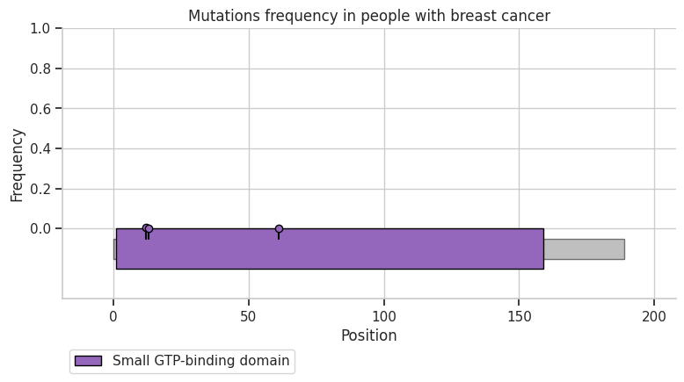
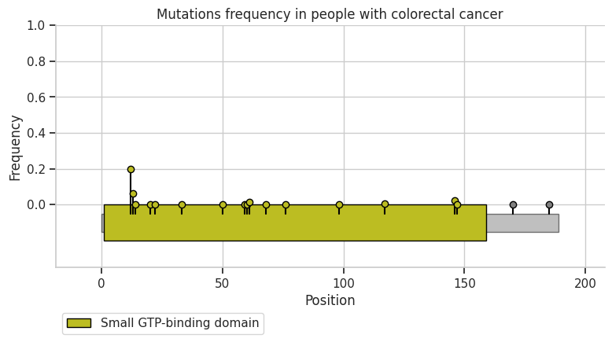
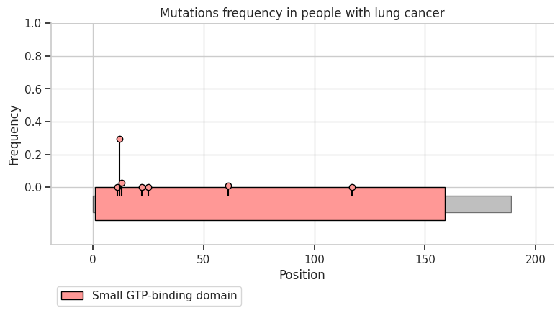
Mutations frequency in other cancers
Source: cBioPortal

Slide 13
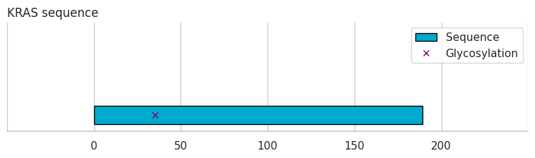
Glycosylations
This plot shows the positions of glycosylations, i.e. the positions of all glycan groups covalently attached to the protein.
35 is a position for O-linked (Glc) threonine glycosylation.
Source: UniProt
Notes:
Source: https://www.uniprot.org/uniprotkb/P01116/entry

Slide 14
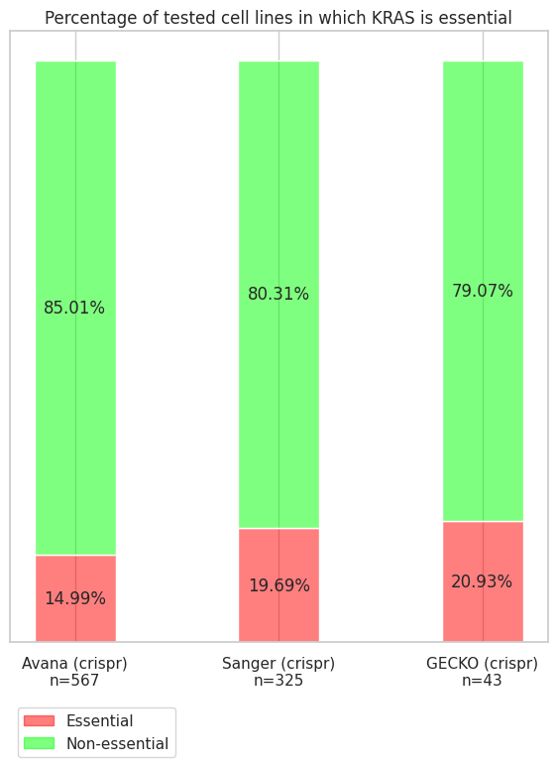
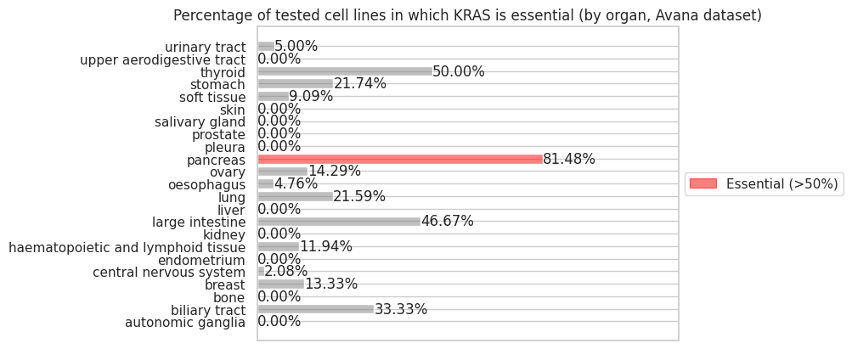
Gene essentiality
Organs in which KRAS is essential (KRAS is essential in more than 50% of the tested cell lines, Avana dataset): pancreas
Source: OGEE
Notes:
Source: https://v3.ogee.info/?#/gene/human/KRAS

Slide 15
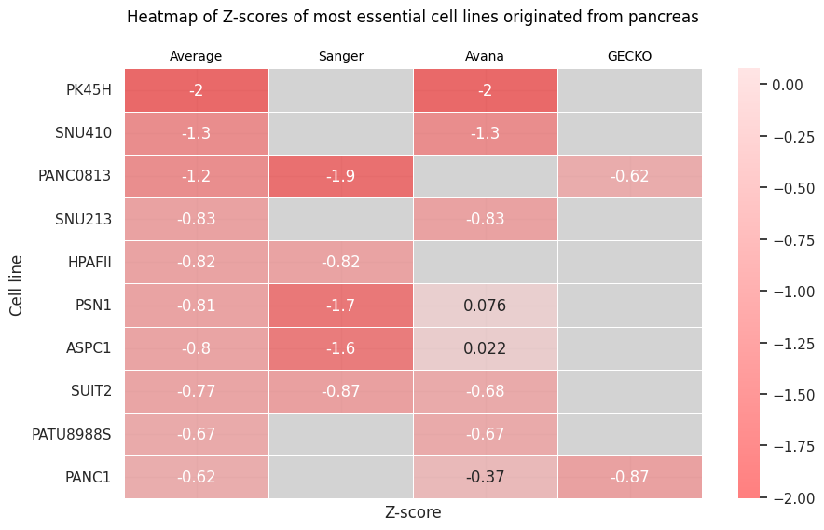
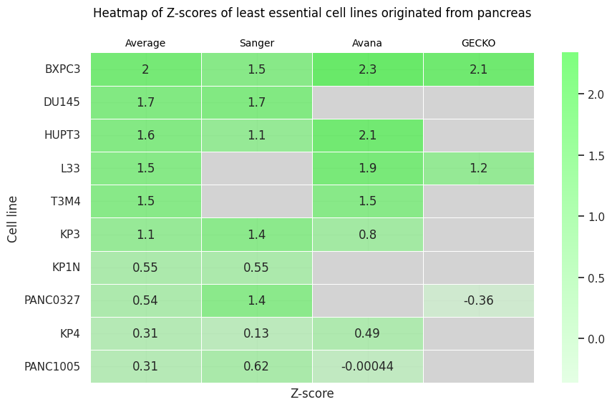
Gene essentiality - pancreas
The scores of each dataset are converted into z-scores. The smaller the z-value associated with the cell line, the more essential KRAS is in that cell line.
Source: OGEE
Notes:
Source: https://v3.ogee.info/?#/gene/human/KRAS

Slide 16
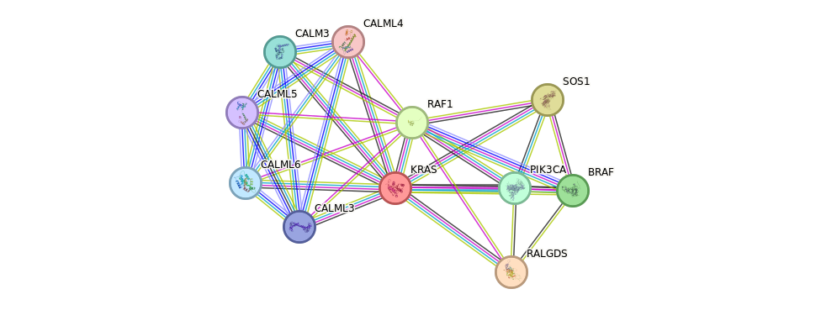
KRAS Protein-Protein interactions
The scores are from 0 to 1 and indicate the confidence: how likely STRING judges an interaction to be true, given the available evidence.
Protein | Score
BRAF | 0.999
RAF1 | 0.999
RALGDS | 0.999
SOS1 | 0.999
CALM3 | 0.998
Protein | Score
CALML3 | 0.998
CALML4 | 0.998
CALML5 | 0.998
CALML6 | 0.998
PIK3CA | 0.998
Source: STRING

Slide 17
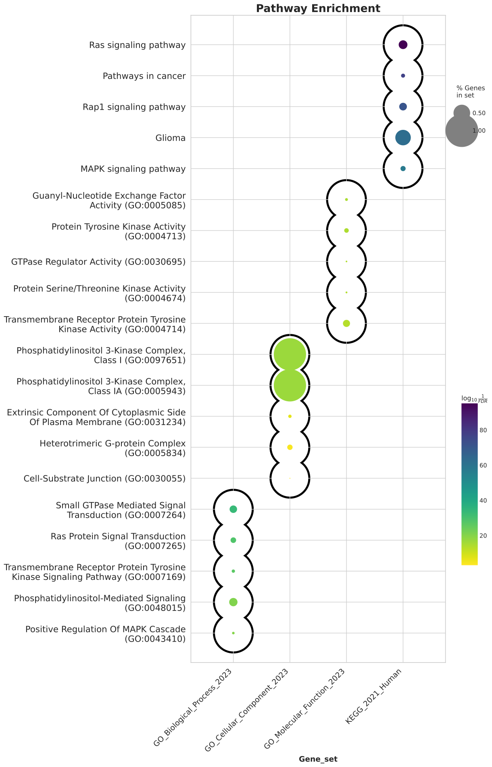
Pathway enrichment
Pathway enrichment analysis for the 100 genes that have the highest interaction with KRAS.
Source: gseapy

Slide 18
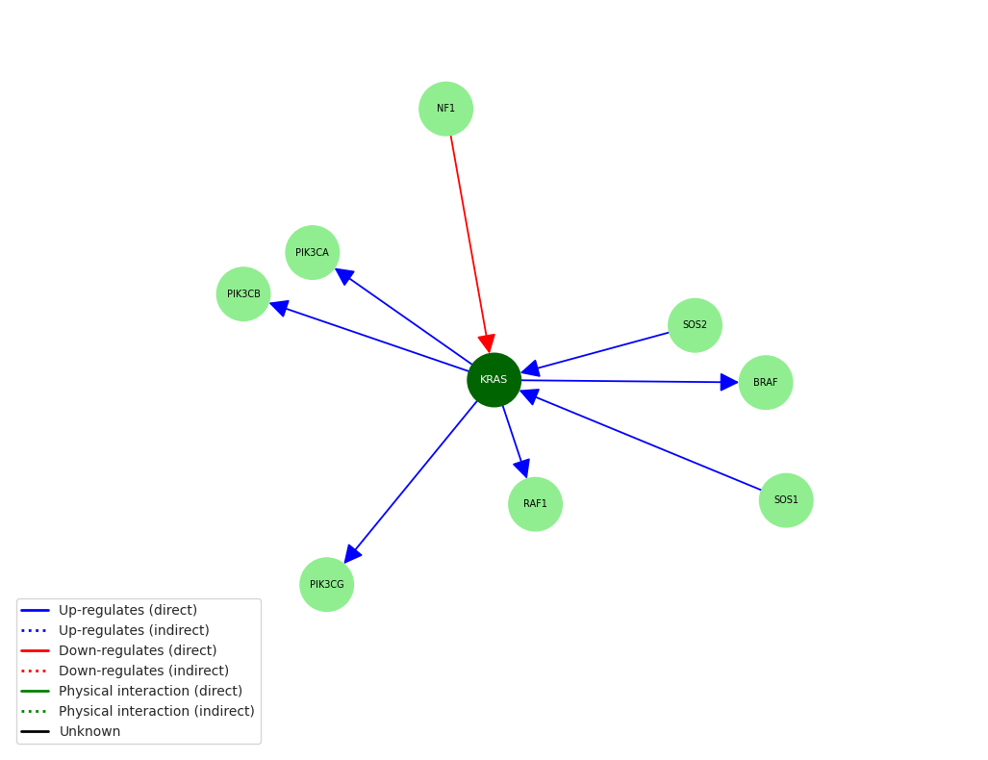
SIGnaling network
Source: Signor 3.0
Full list in the PDF.
Notes:
Source: https://signor.uniroma2.it/relation_result.php?id=P01116

Slide 19
Target role in physiology and tumor progression
KRAS role in physiology
KRAS, a GTPase, is crucial for relaying growth factor receptor signals to cellular pathways controlling proliferation, survival, and migration. Normal KRAS activity is regulated, but mutations at codons 12, 13, or 61 disrupt this balance, leading to persistent activation and cancer. KRAS signaling influences airway epithelial cell differentiation. In the study, KRAS knockdown decreased secretory and ciliated cell differentiation, while KRAS activation increased it. Cigarette smoke enhances KRAS and RAS family protein activation, contributing to airway epithelial remodeling.
KRAS role in tumor progression
KRAS, a common oncogene in lung and pancreatic adenocarcinomas, is linked to poor clinical outcomes in pancreatic cancer. Recent research indicates that KRAS-driven tumor progression may not be entirely independent of upstream signaling. ERBB family RTKs contribute to KRAS-driven lung tumor development and progression. In pancreatic ductal adenocarcinomas (PDAC), KRAS mutations and SMAD4 deficiency accelerate PDAC development and alter tumor phenotype. A non-receptor protein tyrosine phosphatase, SHP2, is essential for KRAS-driven tumors and its inhibition or deletion delays tumor progression. Synergy is observed when targeting both SHP2 and MEK, leading to sustained tumor growth control in murine and human PDAC models. KRAS plays a central role in pancreatic cancer progression, and targeting multiple signaling pathways may be effective for KRAS-mutant cancers.
Source: PubMed
Notes:
Role in physiology: Abstracts PMIDs 31399087, 29748135, 33082413, 38570452, 30041673, 37121193
Role in tumor progression: Abstracts PMIDs 29956571, 29925636, 27494869, 17114584, 29808009, 17690114

Slide 20
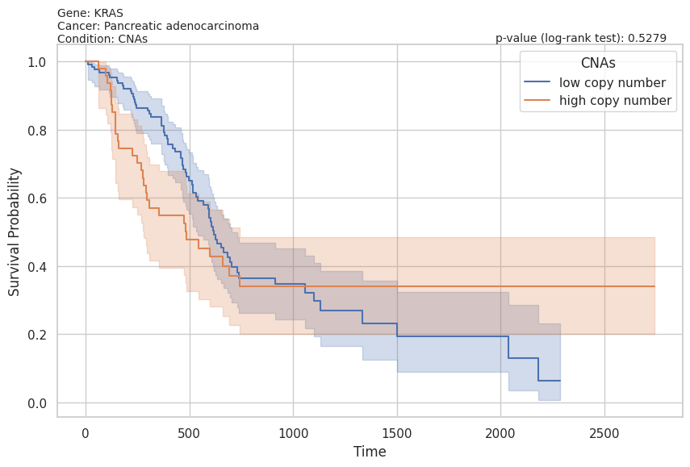
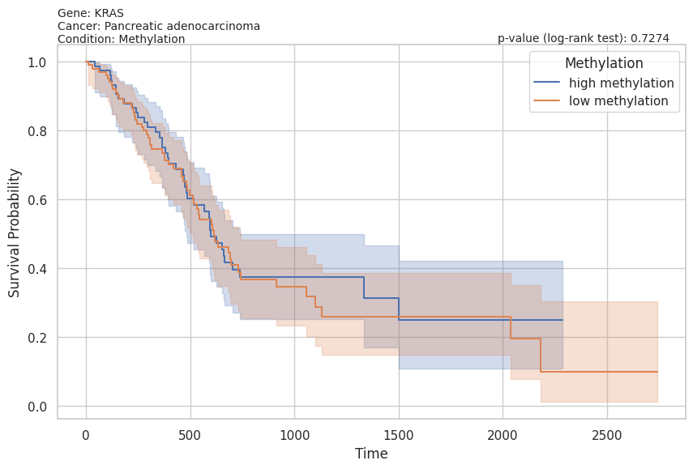
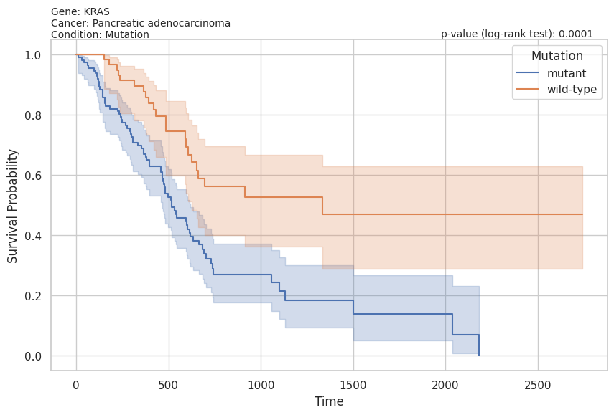
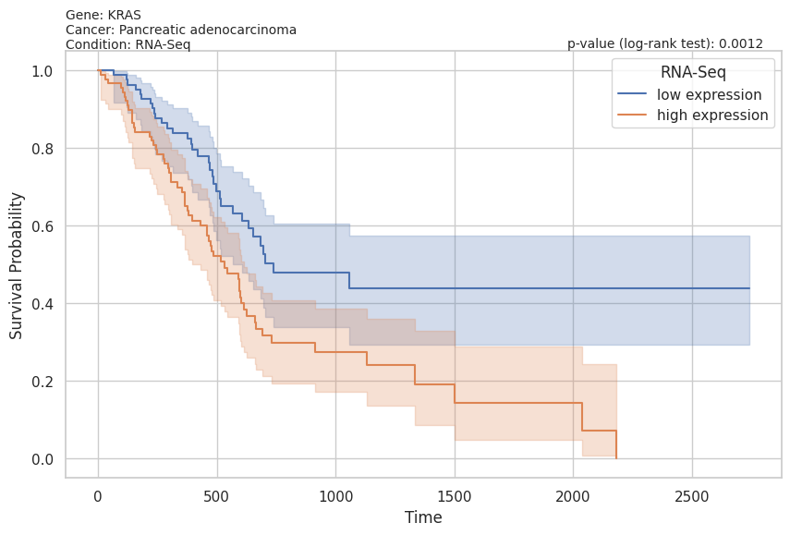
Kaplan-Meier curves
Source: TCGA Survival
Notes:
Source: https://www.tcga-survival.com/data-table?view=gene&gene=KRAS

Slide 21
Pancreatic cancer description
Pancreatic cancer is linked to hyperglycemia and diabetes mellitus, increasing incidence, mortality, and presenting with larger tumors and shorter survival. The role and mechanisms of hyperglycemia in cancer progression are still unknown.
Pancreatic ductal adenocarcinoma (PDAC) is driven by the immune system and KRAS mutations, with low 5-year survival rate. Common inactivating mutations include TP53, CDKN2A, and SMAD4. The cancer microenvironment significantly contributes to PDAC progression.
Pancreatic cancer is a leading cause of cancer deaths with a low 5-year survival rate. Major driver genes include mutated KRAS and inactivated TP53, CDKN2A, and SMAD4. Up to 10% are inherited, with autosomal dominant inheritance in most cases.
Source: PMC
Notes:
Source: Articles PMIDs 6518784, 6065152, 8835700

Slide 22
Pancreatic cancer statistics
Pancreatic cancer, primarily PDAC, is a deadly disease with 496,000 new cases and 466,000 deaths worldwide in 2020. PDAC makes up over 90% of cases, and despite being the 10th most common cancer, it's the 7th leading cause of cancer deaths due to poor prognosis. The 5-year survival rate is under 10%.
The incidence rate of pancreatic cancer is increasing, accounting for nearly 5% of global cancer cases and deaths. Its low survival rate is due to its asymptomatic nature in early stages and the absence of effective biomarkers for early detection.
Pancreatic ductal adenocarcinoma (PDAC) originates from pancreatic cells and is influenced by a complex tumor microenvironment (TME) involving a dense ECM, stromal cells, cancer-associated fibroblasts, and immune cells. Overexpression of ECM proteins like collagen and fibronectin promotes PDAC growth and chemotherapeutic resistance.
Pancreatic cancer has a poor prognosis, emphasizing the importance of early diagnosis and treatment. CA-19-9, a carbohydrate antigen biomarker, is used for diagnosing and managing pancreatic cancer by detecting it in the blood of some patients.
The prevalence and incidence of PNET have risen, accounting for up to 10% of pancreatic tumors in autopsy studies. The global 5-year survival rate for pancreatic tumors, including PDAC and PNET, is around 10%. Low survival is due to late diagnosis, low resectability, early metastasis, and resistance to therapy.
In the US, African Americans have higher pancreatic cancer incidence and poorer survival rates due to social factors like smoking, alcohol, obesity, and diabetes. Genetics also play a role.
Pancreatic cancer (PDAC) is a deadly, aggressive disease with increasing incidence and poor prognosis. Late detection, lack of early biomarkers, and chemoresistance contribute to low survival rates. Global efforts focus on early diagnosis and treatment, with CA-19-9 as a crucial diagnostic tool.
Source: PMC
Notes:
Source: Articles PMIDs 7553299, 10551021, 10632485

Slide 23
Pancreatic cancer standard of care
Pancreatic cancer is a deadly disease with poor prognosis, often diagnosed late for R0 surgery. In China, it's the 7th leading cause of cancer deaths, with nearly equal numbers of deaths and new cases annually. Standard treatment for advanced and metastatic pancreatic cancer is chemotherapy, with Nab-paclitaxel plus gemcitabine (AG) and modified FOLFIRINOX as first-line options based on clinical trials.
The PRODIGE4/ACCORD11 and MPACT trials in 2011 and 2013 showed that FOLFIRINOX and gemcitabine plus nab-paclitaxel had better survival benefits than gemcitabine monotherapy in metastatic pancreatic cancer patients. These two regimens are now the standard first-line treatment.
For over two decades, gemcitabine monotherapy has been the standard treatment for metastatic pancreatic cancer. Combination regimens with other drugs haven't significantly improved survival, except for erlotinib, which, when used with gemcitabine, provides a marginal increase in median survival time.
FOLFIRINOX significantly improves overall survival and quality of life compared to gemcitabine in metastatic pancreatic cancer patients, making it the standard treatment for those with good performance status in North America and Europe.
The standard treatment for pancreatic cancer is chemotherapy, with Nab-paclitaxel plus gemcitabine (AG) and modified FOLFIRINOX being the recommended first-line options based on clinical trials. More effective treatments are needed as gemcitabine monotherapy has been the standard for over two decades. FOLFIRINOX improves overall survival and quality of life compared to gemcitabine.
Source: PMC
Notes:
Source: Articles PMIDs 9869579, 6718524, 4462360

Slide 24
Pancreatic cancer ESMO guidelines
Management of local and locoregional disease
ESMO guidelines recommend surgical resection as the only potentially curative treatment for pancreatic cancer. Upfront surgery is the standard for resectable tumors, with pancreatoduodenectomy for head tumors and distal pancreatectomy for body/tail tumors. Neoadjuvant therapy is not well-established for resectable disease, but it is recommended for borderline resectable and locally advanced disease. For borderline resectable disease, induction therapy improves OS. For locally advanced disease, induction therapy increases the possibility of R0 resection. Standard lymphadenectomy is recommended, and perioperative thromboprophylaxis is necessary. Following resection, adjuvant chemotherapy is strongly recommended. Patients with borderline resectable disease have a high probability of R1 resection and should be considered for induction treatment. For locally advanced disease, conversion therapy is suggested, and exploration for resection could be discussed if there is significant tumor downstaging. Arterial resection after induction therapy is not recommended but can be considered in experienced centers on a case-by-case basis.
Source: ESMO

Slide 25
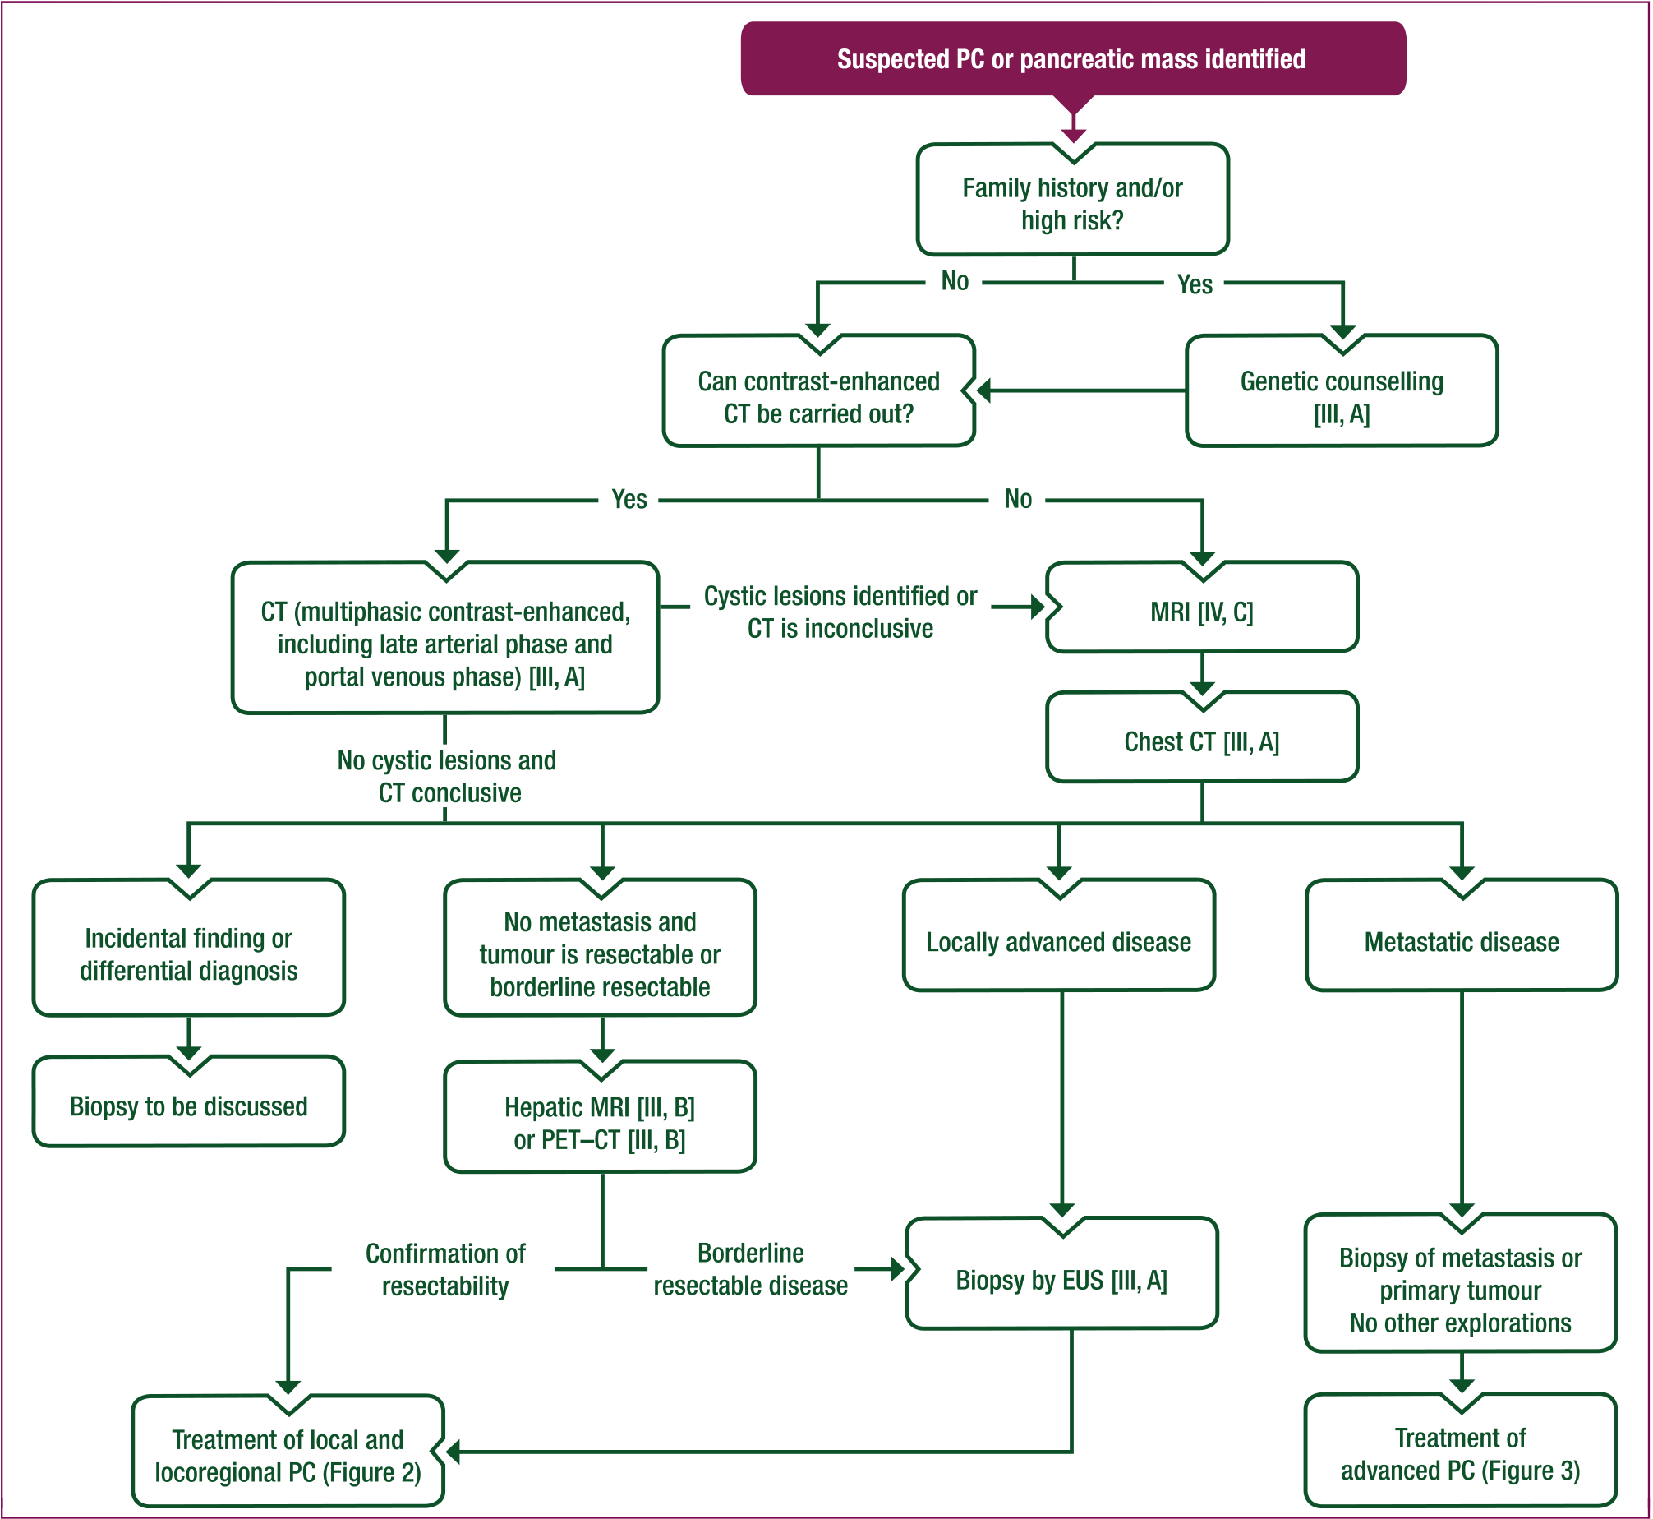
Pancreatic cancer ESMO guidelines
Figure 1. Diagnostic work-up of suspected PC. Purple: general categories or stratification; white: management.

Slide 26
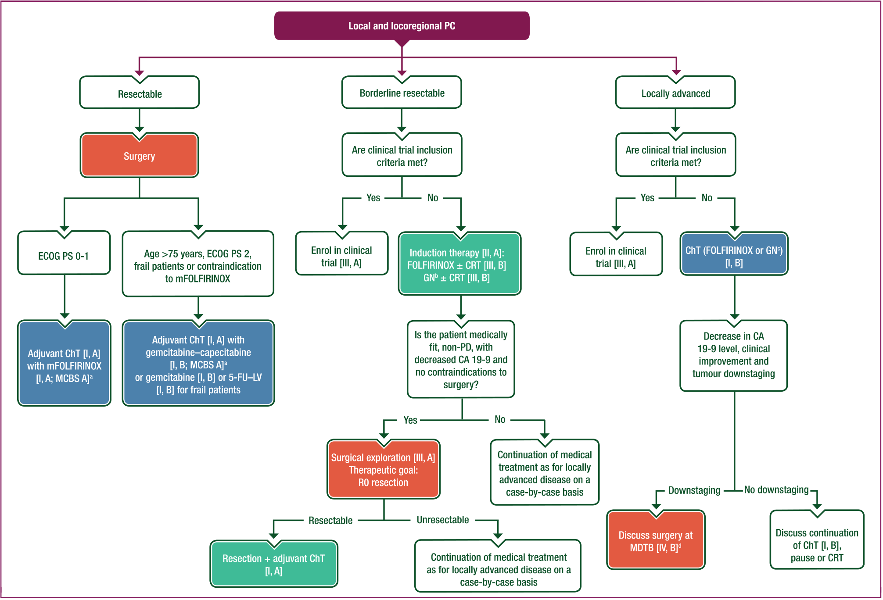
Pancreatic cancer ESMO guidelines
Figure 2. Treatment algorithm for local and locoregional PC. Purple: general categories or stratification; red: surgery; blue: systemic anticancer therapy; turquoise: combination of treatments; white: other aspects of man-agement.

Slide 27
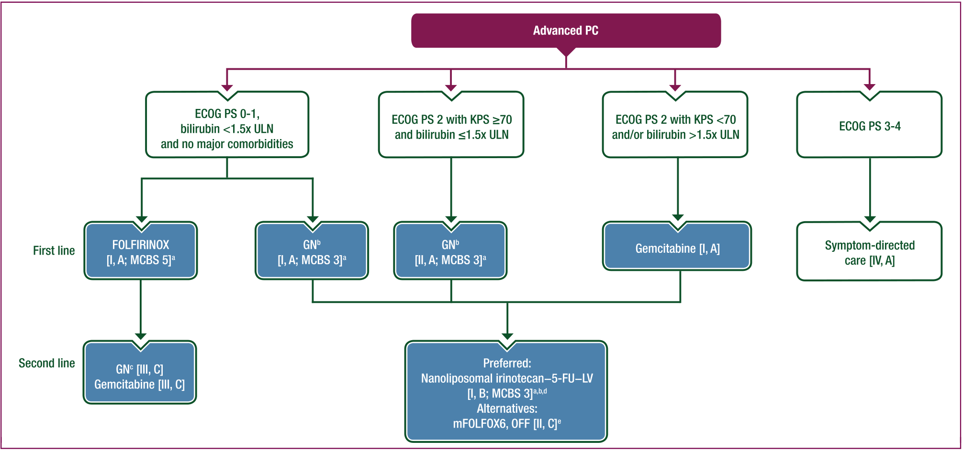
Pancreatic cancer ESMO guidelines
Figure 3. Systemic treatment of advanced PC. Purple: general categories or stratification; blue: systemic anticancer therapy; white: other aspects of management.

Slide 28
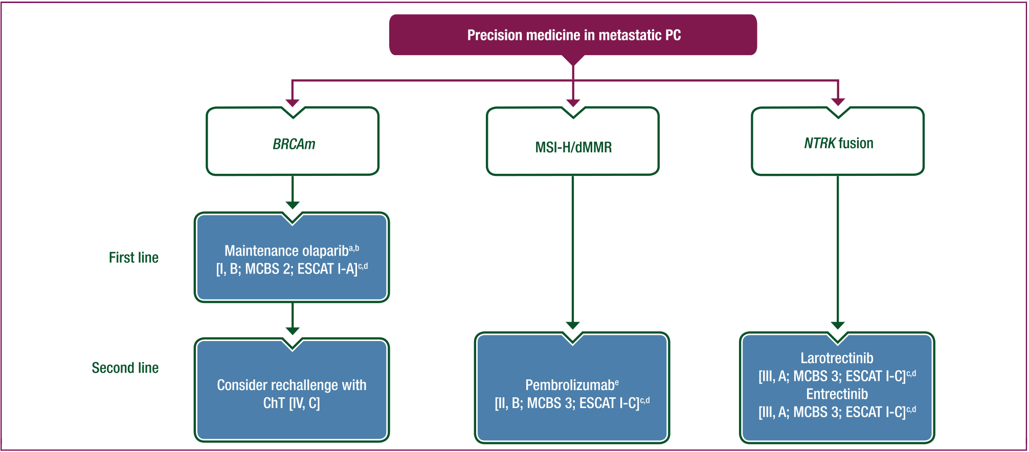
Pancreatic cancer ESMO guidelines
Figure 4. Precision medicine in metastatic PC. Purple: general categories or stratification; blue: systemic anticancer therapy; white: other aspects of management.

Slide 29
Pancreatic cancer current therapies and limitations
Current therapies for pancreatic cancer include surgery, chemotherapy, and radiation therapy. Surgery is the most effective treatment but is only suitable for a minority of patients due to the disease's advanced stage at diagnosis and difficulty in removing all cancer cells. Chemotherapy and radiation therapy are used to slow down the disease progression and improve symptoms, but they have limited efficacy and significant side effects.Limitation of Surgery:- Only suitable for a minority of patients- Difficulty in removing all cancer cellsLimitation of Chemotherapy and Radiation Therapy:- Limited efficacy- Significant side effects.
Source: PMC
Notes:
Source: Articles PMIDs 3590245, 4849685, 9185216

Slide 30
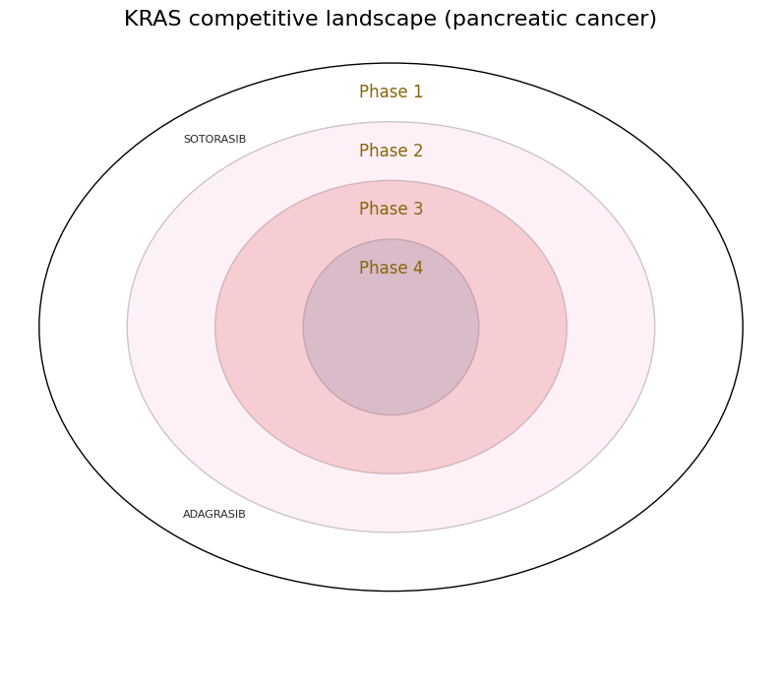
Known drugs targeting KRAS
Drug | Type | Action type | Phase
SOTORASIB | Small molecule | Inhibitor | 1
ADAGRASIB | Small molecule | Inhibitor | 1
Source: Open Targets
Drugs full list available on the target dossier PDF.
Notes:
Source: https://platform.opentargets.org/target/ENSG00000133703

Slide 31
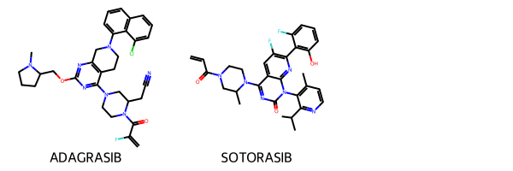
Known drugs targeting KRAS
*Molecules information in the PDF.
Source: DrugBank and NCBI PubChem Compound

Slide 32
SWOT analysis
Strengths:
1. Significant target: KRAS is a frequently mutated oncogene in pancreatic cancer, making it a significant target for drug development.
2. Solid foundation: The availability of KRAS mutation data and the understanding of its role in pancreatic cancer progression provide a solid foundation for drug development efforts.
3. Central role: KRAS signaling plays a central role in pancreatic cancer progression, making it an attractive target for therapeutic intervention.
Threats:
1. Complexity: Developing a drug for KRAS is a complex and challenging process due to the presence of a desmoplastic tumor microenvironment and the lack of effective biomarkers to guide treatment.
2. Competition: Several companies are already working on KRAS-targeted therapies, increasing the competition in this area.
3. Mortality rate: The high mortality rate of pancreatic cancer and the limited market size due to the low survival rate pose significant threats to drug development efforts.

Slide 33
SWOT analysis
Weaknesses:
1. Current standard: The modest beneficial outcome of gemcitabine, the current standard of care, necessitates the exploration of combination therapies and alternative treatment options.
2. Complexity: The complex nature of pancreatic cancer and the presence of a desmoplastic tumor microenvironment increase the risk of drug development efforts.
3. Lack of understanding: The absence of a clear understanding of the mechanisms underlying KRAS-driven tumor progression poses challenges in developing effective KRAS-targeted therapies.
Opportunities:
1. Precision medicine: Utilizing precision medicine, such as BRCA mutations, MSI-H/dMMR, and NTRK fusions, can make drug development efforts more efficient by focusing on specific patient populations.
2. Therapeutic areas: The potential therapeutic area segments, such as combination therapies and immunotherapy, offer opportunities for expanding the scope of KRAS-targeted drug development.
3. Advancements: Advancements in technology, such as CRISPR-Cas9 gene editing and RNA interference, offer opportunities for developing novel KRAS-targeted therapies.

Slide 34
Conclusions
KRAS is a significant therapeutic target for pancreatic cancer due to its frequent mutation and role in cancer progression.
Challenges in drug development include the complex nature of pancreatic cancer, the presence of a desmoplastic tumor microenvironment, and the lack of effective biomarkers and understanding of KRAS-driven progression mechanisms.
Opportunities for expanding KRAS-targeted drug development include combination therapies and immunotherapy.

